Slide 1
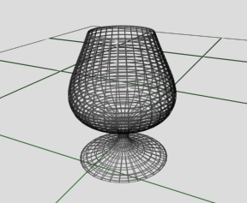
3-D Object Modeling
Computer Graphics - 8

Slide 2
There are basically two ways to model objects in 3-D
Space-partitioning (Solid modeling)
  Describe interior as union of solids
  Parametric modeling
    what parameters would we use?
Boundary representations (B-reps)
  Describe the set of surfaces
    That define the exterior surface of an object
    That separate object interior from exterior
    What kinds of surfaces?

Slide 3
Most common is Boundary Representation
Advantage: surface equations are linear
Representing objects:
  Polyhedrons - no problem
  General shapes - approximation
    Tessellate (subdivide) to polygon mesh

Slide 4
Polygon Meshes can be used to describe a general surface
Replaces it with an approximation
Common sets of polygons
  Triangles
    Advantage: 3 vertices determine plane
  Quadrilaterals

Slide 5
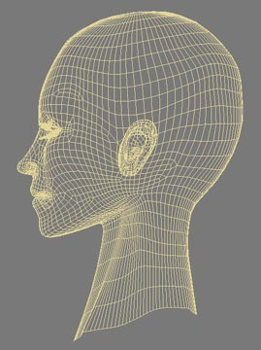
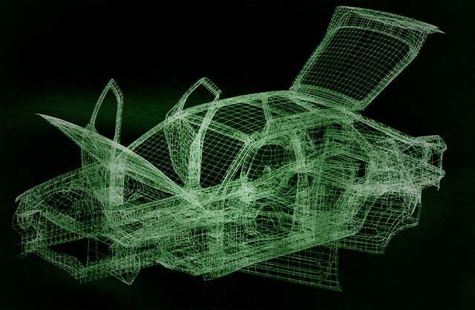
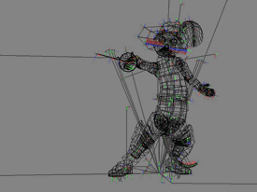
Polygon Meshes

Slide 6



Polygon Description
Geometric data
  Description of position and shape
Attribute data
  Description of surface
    Color
    Transparency
    Surface reflectivity
    Texture

Slide 7
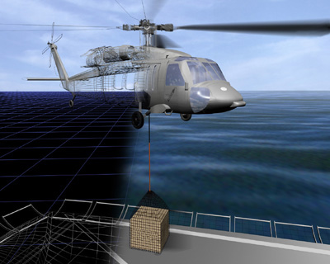
Polygon Description

Slide 8
How do you represent a polygon surface approximation?
List of vertices (in 3-D) could work
  Sufficient description
  But, polygons are joined
    Shared vertices and edges
We need a more general description that
  Reduces redundancy
  Represents component polygons

Slide 9
Polygon Tables
Vertex table
  For all polygons in composite object
Edge table
  Each edge listed once
    Even if part of more than one polygon
Polygon-surface table
Pointers or other links between tables for easy access

Slide 10
Polygon Table Example
V₁
E₈
E₁
E₁: V₁,V₃
E₂: V₁,V₂
E₃: V₂,V₃
E₄: V₁,V₄
E₅: V₃,V₄
E₆: V₄,V₅
E₇: V₂,V₅
E₈: V₁,V₅
E₂
E₇
E₃
V₂
S₁: E₁, E₂, E₃
S₂: E₂, E₇, E₈
S₃: E₁, E₄, E₅
S₄: E₄, E₆, E₈
S₅: E₃, E₅, E₆ , E₇
E₄
V₅
V₃
E₆
E₅
V₄

Slide 11
Polygon surfaces can be represented by Plane Equations
Often need information on
  Spatial orientation of surfaces
    Visible surface identification
    Surface rendering (e.g. shading)
Processing a 3-D object involves
  Equations of polygon planes
  Coordinate transformations (3-D)

Slide 12
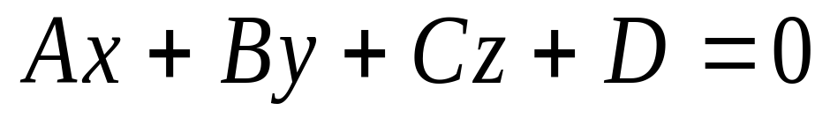
The Plane Equation
Must be satisfied for any point (x,y,z) in the plane.
We want to solve for coefficients (A, B, C, D).
How many points define a plane?
How many unknowns are there?

Slide 13

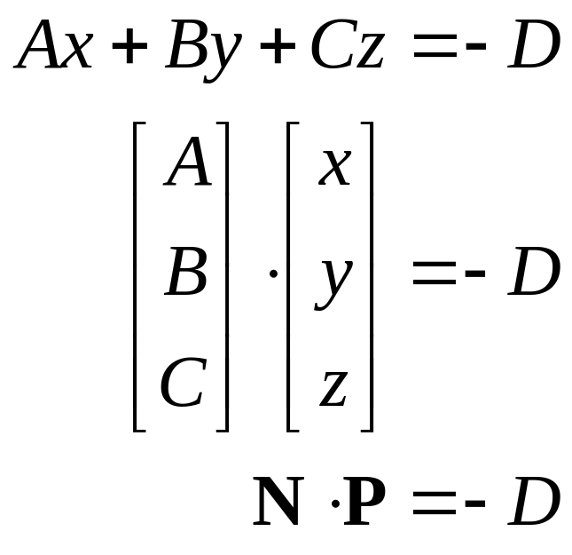
Vector Formulation
Solving for D in the plane equation:
N
P

Slide 14
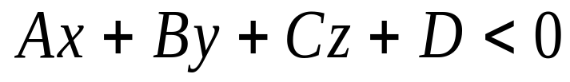
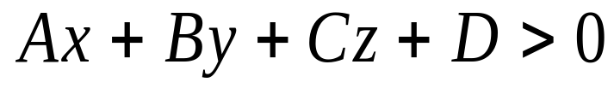
Testing Points
If point is “inside” the plane, then:
If point is “outside” the plane, then:
P_{outside}
This can be used to determine what surfaces are hidden
N
P_{inside}

Slide 15
Summary
In today’s lecture we looked at:
  Transformations in 3-D
    Very similar to those in 2-D
  Projections
    3-D scenes must be projected onto a 2-D image plane
    Lots of ways to do this
      Parallel projections
      Perspective projections
    The virtual camera
  3-D Object Modeling

